Slide 1
Week 9
Object-Oriented Analysis And Design

Slide 2
Introduction
Object-Oriented Analysis And Design involves Use Case and Activity Diagram
Use cases are a different way to model the functionality of a business process

Slide 3
Use Cases (1 of 2)
Use case – depiction of a system’s behavior or functionality under various conditions as the system responds to requests from users
Actor – external entity that interacts with a system

Slide 4
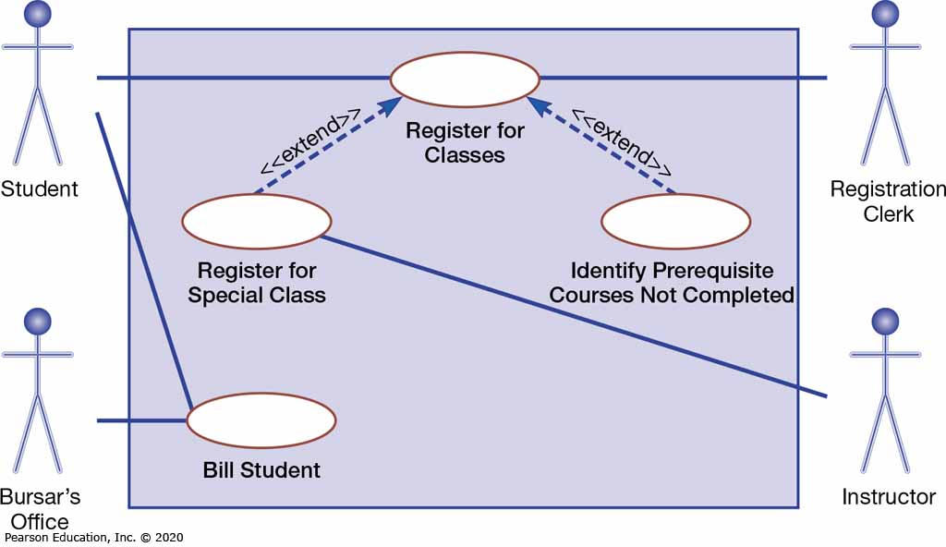
Figure 1: A Use Case Diagram for a University Registration System

Slide 5
Use Cases (2 of 2)
A use case:
  Can be stated as a present-tense verb
  Describes the behavior of a system in response to requests from actors
  Do not reflect all system requirements
  Consists of actors and use cases
  To identify a use case, ask the following questions:
    What are the main task performed by each actor?
    Will the actor read or update any information in the system?
    Will the actor have to inform the systems about changes outside the system?
    Does the actor have to be informed of unexpected changes?

Slide 6
Use Case Diagrams
Use case diagram – picture showing system behavior, along with the key actors that interact with the system
  Initiated by an actor
  Represents complete functionality
Abstract use case – use case that is initiated by another use case

Slide 7
Definitions and Symbols (1 of 2)
Actor is a role, not an individual represented by stick figures
Use case is represented by an ellipse and represents a single system function
System boundary, represented by a box, includes all the relevant use cases (actors are outside the system boundary)
Connections are an association between an actor and a use case and is represented by arrows

Slide 8
Definitions and Symbols (2 of 2)
Extend relationship – association between two use cases where one adds new behaviors or actions to the other
Include relationship – association between two use cases where one use case uses the functionality contained in the other

Slide 9
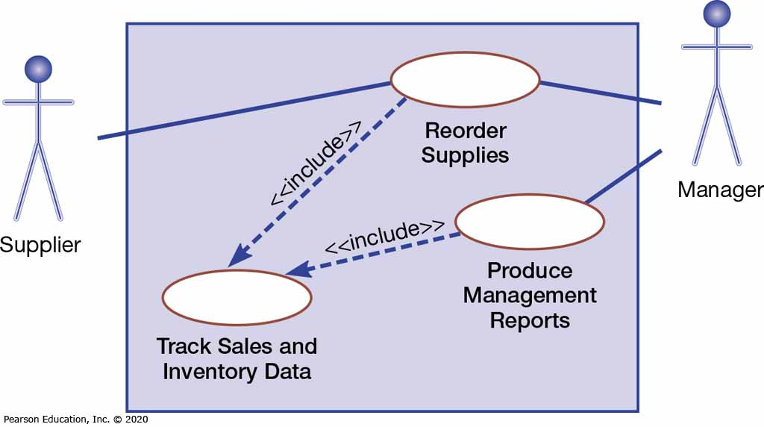
Figure 2: A Use Case Diagram Featuring an Include Relationship

Slide 10
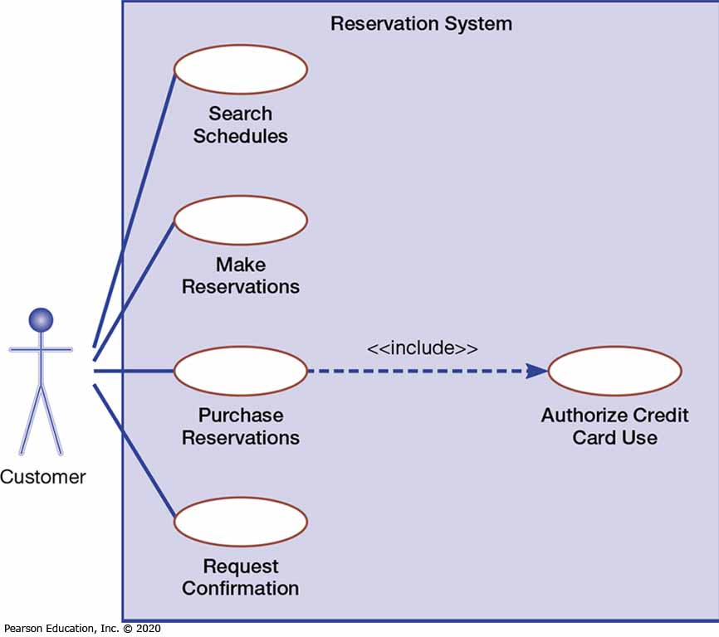
Figure 3: A Use Case Diagram for a Reservation System
(Source: George, J. F., Batra, D., Valacich, J. S., & Hoffer, J. A. (2007). Object oriented systems analysis and design (2nd Ed.) (pp. 174, 168, 175, 172, 176, 177). Reprinted and Electronically reproduced by permission of Pearson Education, Inc., New York, NY.)

Slide 11
Activity Diagrams (1 of 3)
Activity diagrams show the conditional logic for the sequence of system activities needed to accomplish a business function
  Show the order in which the action take place and identify the outcomes.

Slide 12
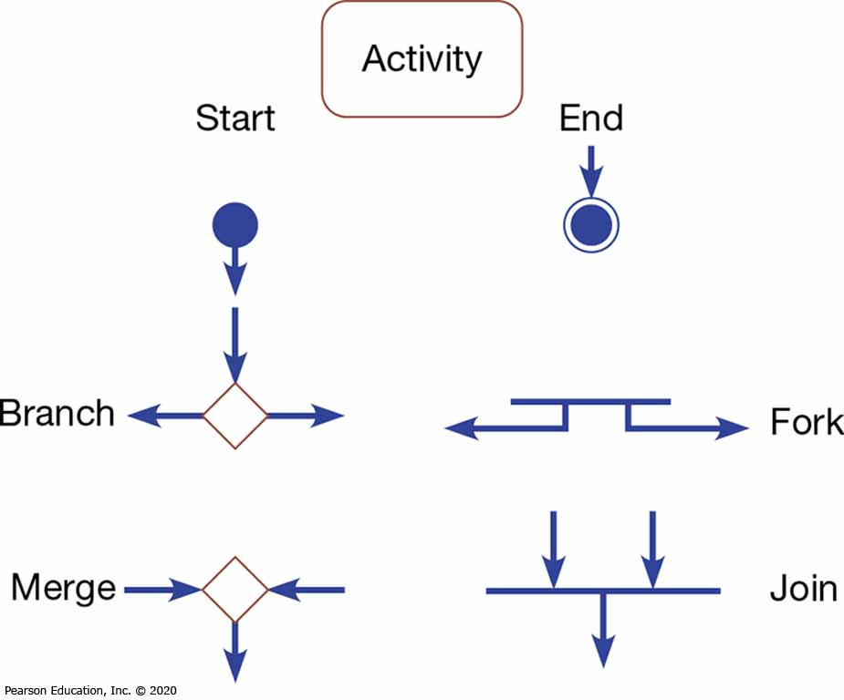
Figure 4: Basic Notation for Activity Diagrams

Slide 13
Activity Diagrams (2 of 3)
Elements of activity diagrams:
  Activity: a rounded rectangle representing a behavior carried out while in a particular state
  Branch: a diamond symbol representing a choice that must be made
  Merge: also a diamond symbol representing where two arrows come together but only one leaves
  Fork: a horizontal line representing where two parallel activities begin
  Join: also a horizontal line representing where two activities come together but only one leaves
  Swimlane: columns representing different organizational units of the system

Slide 14
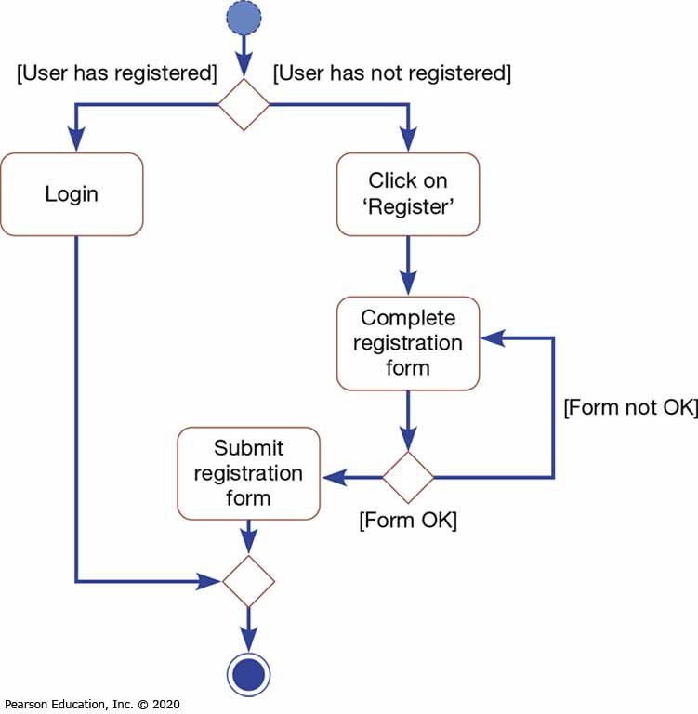
Figure 5: Simple Activity Diagram Showing Conditional Logic

Slide 15
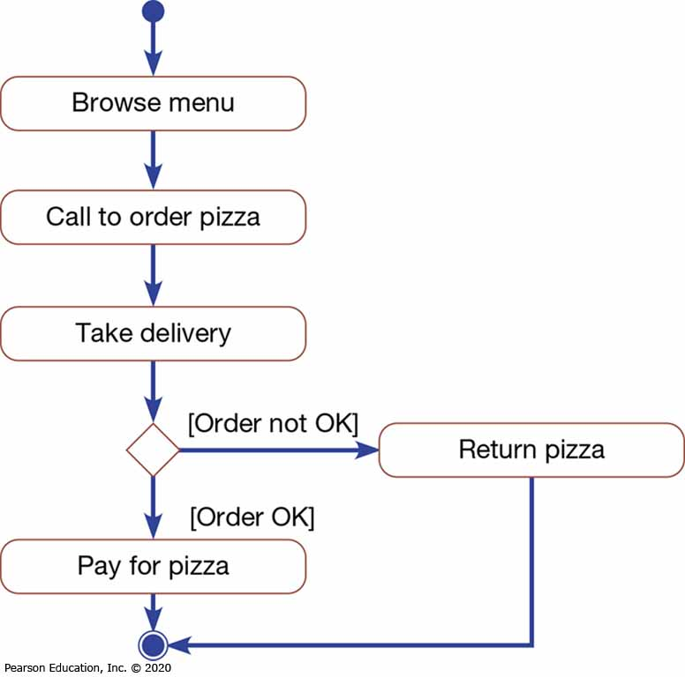
Figure 6: Simple Activity Diagram Showing Conditional Logic

Slide 16
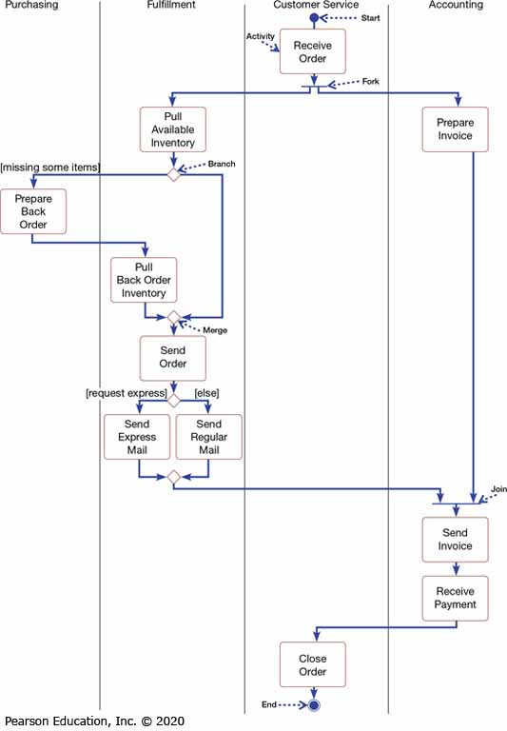
Figure 7: Activity Diagram for a Customer Order Process

Slide 17
Activity Diagrams (3 of 3)
Use activity diagrams to:
  Depict the flow of control from activity to activity
  Help in use case analysis to understand what actions are needed to take place
  Help in identifying extensions in a use case
  Model work flow and business processes
  Model the sequential and concurrent steps in a computation process

Slide 18

Use Case Diagram Exercise
Draw Use Case Diagram for Airline Ticketing process

